Slide 1
Comparative Study on Forecasting China’s CPI Using Mixed-Frequency Data and Machine Learning
Course name: ECO6130
Group members：刘怡然，韩心怡，卓欣宜，宋英竹，蔡曼莎
Notes:
简单介绍课题
说明核心目标：用混频数据预测中国 CPI，并比较不同模型表现

Slide 2
Why CPI Forecasting Matters
CPI is a key indicator of inflation and macroeconomic conditions
Accurate forecasting helps monetary policy, financial decisions, and risk management
Traditional models rely mainly on monthly data and may react slowly to turning points
Monthly data are lagged and may miss turning points within the month
so we introduce high-frequency alternative data to improve timeliness.

Slide 3
Research Question and Overall Framework
workflow：
Raw data → preprocessing & alignment → feature engineering → model comparison → forecast & conclusions
3 models: Random Forest/ PCA + OLS/ Dual-Encoder Feature Fusion Network
Main question:
Can mixed-frequency data improve CPI forecasting?
Do high-frequency indicators provide additional predictive value?

Slide 4
Data and Variable Selection
High-frequency variables | Low-frequency variables
OMO net injection, cement price index, commercial housing transaction area, existing-home listing price index, pork wholesale price, Nanhua industrial goods index, subway ridership | social financing stock growth, electricity generation growth, export growth, import growth, PPI intermediate goods, PPI consumer goods
High-frequency variables→short-term changes low-frequency variables →macro fundamental aspects.

Slide 5
Preprocessing and Mixed-Frequency Alignment
Raw Data → Frequency Conversion → Missing Value Handling → Target Alignment
1. Daily / weekly / monthly variables
2. Mixed release frequencies
1. Split each month into 3 ten-day periods
2. Average valid observations
1. Fill missing OMO values with 0
2. Based on economic logic
1. Exclude Jan–Feb as direct targets
2. Use Jan–Mar high-frequency averages to forecast March CPI
Output: A unified mixed-frequency dataset for model training

Slide 6
Exploratory Data Analysis
figure： correlation heatmap
PPI for consumer goods shows the strongest positive correlation with CPI
Some high-frequency variables also correlate with CPI, suggesting incremental predictive value
Correlations among high-frequency variables indicate multicollinearity, which motivates PCA
Notes:
take correlation heatmap for instance

Slide 7
Model Overview
Model | Why chosen | Main idea
PCA + OLS | linear benchmark | reduce multicollinearity, then regress
Random Forest | robust under small samples | nonlinear tree ensemble
Dual-Encoder | designed for mixed-frequency sequences | separate encoding + feature fusion
We compare a linear benchmark, a nonlinear ensemble model, and a mixed-frequency deep learning model.

Slide 8
Traditional Models: PCA+OLS and Random Forest
PCA + OLS
Aligned dataset → Monthly aggregation → Standardization → PCA → OLS prediction
Random Forest
210-dimensional feature vector → Multiple decision trees → Averaged prediction
Aligned dataset:
mixed-frequency features after preprocessing
Monthly aggregation:
high-frequency variables compressed to monthly level
Standardization:
required before PCA
PCA:
reduce multicollinearity and noise
OLS:
linear benchmark for CPI forecasting
captures nonlinear relationships
robust under small-sample settings
provides feature importance
Notes:
这里可以用流程图，然后每个框下面放对应注释

Slide 9
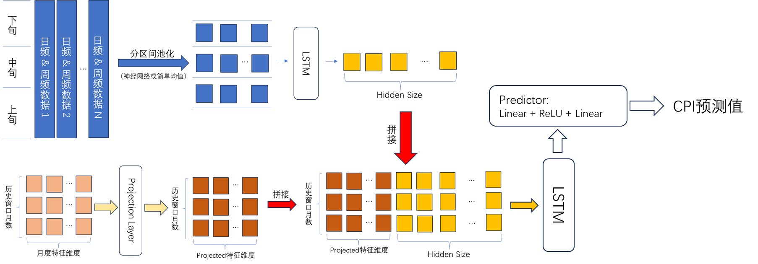
Dual-Encoder Architecture
The dual-encoder structure preserves frequency differences and integrates both short-term and macroeconomic information for CPI forecasting.

Slide 10
Model Performance Comparison
Model | MSE | MAE | RMSE | R²
Random Forest | 0.6545 | 0.5407 | 0.6508 | 0.1872
Dual-Encoder | 0.9525 | 0.7527 | 0.8805 | -0.7337
PCA+OLS | 2.5931 | 1.3997 | 1.6042 | -9.9784
Random Forest: best overall, only positive average R²
Dual-Encoder: better than PCA+OLS, but still overfits
PCA+OLS: worst performance, fails to capture nonlinear CPI dynamics

Slide 11
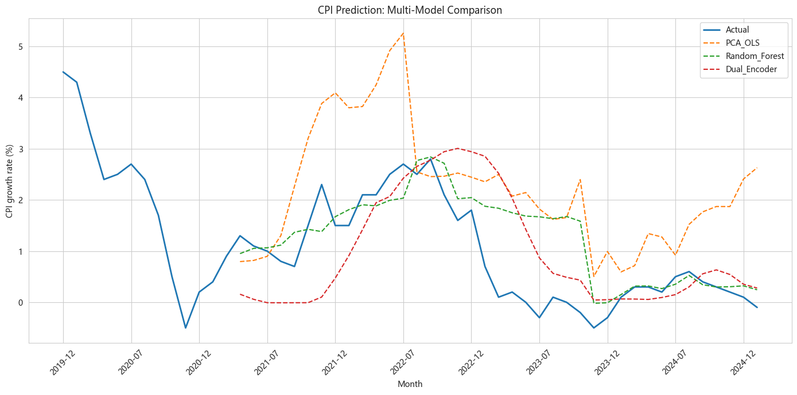
Prediction Curve Comparison
Figure: Line Chart of Multi-Model Fitting Comparison for CPI Forecasting
Notes:
•Random Forest is the most consistent with the real CPI trend and can better track the medium-term fluctuation trend of CPI
•Dual-Encoder is too smooth, has insufficient ability to capture short-term large fluctuations in CPI, and has obvious lag
•PCA_OLS fluctuates violently and completely deviates from the real value, with no practical predictive value

Slide 12
Feature Importance and Economic Logic
CPI’s own lag terms dominate prediction → strong inflation inertia
PPI variables rank highly → upstream-to-downstream price transmission
Pork price enters top features → evidence of the pig cycle effect
High-frequency variables add information, but their contribution is still secondary to core macro variables

Slide 13
Interpretation and Conclusion
Interpretation
1. CPI lag terms dominate prediction, indicating strong inflation inertia
2. PPI-related variables rank highly, suggesting upstream-to-downstream price transmission
3. Pork price remains informative, reflecting the pig cycle effect
4. High-frequency variables provide additional information, but their contribution is secondary to core macro indicators
Conclusion
1. Random Forest performs best overall in this study
2. Mixed-frequency data improve timeliness and provide incremental predictive value
3. Complex deep learning models show potential, but overfitting remains a challenge under small-sample conditions

Slide 14
Future Work
1. Expand the feature space
Incorporate text-based information such as policy reports, financial news, and sentiment indicators
2. Improve model robustness
Apply stronger regularization, optimize hyperparameters, or explore transfer learning
3. Enhance the fusion mechanism
Introduce attention-based or dynamic weighting methods to better capture different macroeconomic cycles

